Slide 1
DX SCHEDULING
TECHFEST 2021
INNOVATIVE BUSINESS MODEL

Slide 2
INTRODUCTION
DX Scheduling is a web-based solution provider that helps mitigate the boredom of manual scheduling.
It provides companies with optimized scheduling plans for their order processing in warehouses and order transportation.
Making use of state-of-the-art genetic algorithms, DX Scheduling aims at reducing the total costs and durations for companies, thus helps grow the profit margin.
It takes companies’ resources (employees, vehicles, equipments) into consideration to produce the most optimized scheduling plans that will surely satisfy customers.
Notes:
// 4 câu

Slide 3
PROJECT’S NAME & COMPETITION TRACKS
Project’s name: ??
Competition tracks: Innovative Business Model

Slide 4


2. CORE TEAM MEMBERS PROFILE
Dr. Vu Thi Huong Giang
Team lead
Tran Manh Cong
Team member
Nguyen Thi Hong Anh
Team member
Le Hoang Anh Trung
Team member
Lecturer at
Hanoi University of Science and Technology
Provide ideas and manage team
Graduate at
Hanoi University of Science and Technology
Take care of Order Transportation Optimization
Undergraduate at
Hanoi University of Science and Technology
Take care of Order Transportation Optimization
Undergraduate at
Hanoi University of Science and Technology
Take care of Order Transportation Optimization

Slide 5
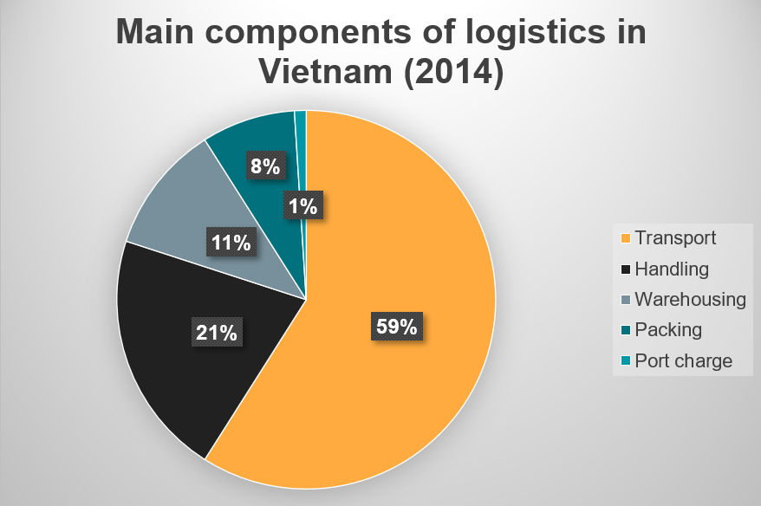
3. Context
Overall logistics cost in Vietnam over GDP in 2018: 16.08%
World’s costs over GDP: 10.70% (Armstrong & Associate March 6, 2020)
Logistics cost in Vietnam in 2014: transport- 59%, handling - 21%, warehouse- 8%.
Higher cost due to outdated machinery, technology. However, it is expensive to replace all machines
Source: Vietnam Logistics Report 2020

Slide 6
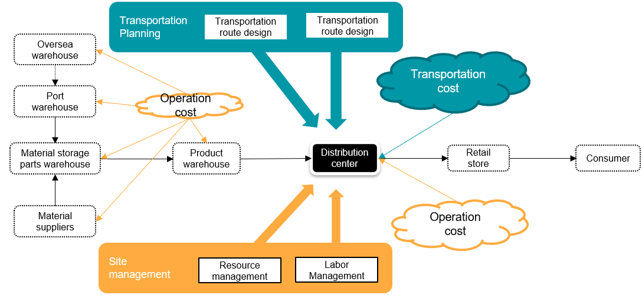
3. Problem (1)
Notes:
Two most costly logistics operations: transportation and warehouse
High logistics costs, especially in transportation, handling and warehouse
⇔ smaller profit margins for companies / corporations.
→ Need to lower costs for transportation, handling and warehouse to increase profit margins
→ Focus on warehouse/inventory and distributor.

Slide 7
3. Problem (2)
4 categories of warehouse costs:
Handling: labor, equipments
Storage
Operations administration: administrators, clerks, labors salaries
General administrative expenses: Executive salaries
→ Most aspects are related to employee’s salaries in the warehouse.
A solution provided is to use flexible workforce rather than full-time employees
Main components of road transportation costs: *
Fixed costs: Road infrastructure
Variable costs: Maintenance, Labor, Fuel
→ Reduce transportation cost by reducing variable costs, especially labor and fuel.
→ Labor wage is time-related whereas fuel is distance-related.
→ The goal is to transport as many order as possible within the shortest time and distance and cost the least. This can be achieved with effective schedules.
*Understanding warehouse costs and risks - Thomas W.Speh
*Fixed and operating transport costs

Slide 8
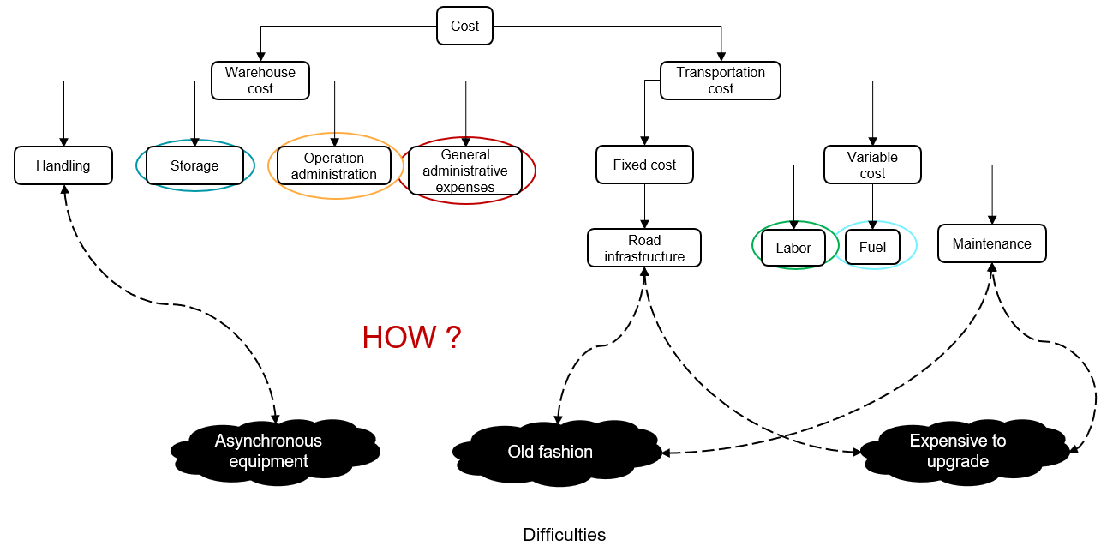
3. Problem (1) difficulty
Notes:
Difficulty:
Obsolete facilities
Asynchronized devices, machines
Upgrading existing facilities is challenging due to high budget
Limited logistics services

Slide 9
3. Solution
Reduce total costs by focusing on the following costs:
Warehouse costs:
Storage
Labor expenses
Transportation costs:
Fuel
Labor expenses
How to ?
Labor expense: reduce by assigning tasks to qualified employees with lower wage coefficients
Fuel: Allocate equipments efficiently, find shortest routes for transportation
Storage: Efficient order push out and order transportation
→ Can be solved by scheduling
*Understanding warehouse costs and risks - Thomas W.Speh
*Fixed and operating transport costs
Notes:
Different orders has different requirements, the most notable is the deadline assigned by the customer.
In order to find balance between customer’s time requirements and total costs, companies can design suitable schedules as scheduling can:
Assign suitable time slots to orders
Assign employees to work on order that are experienced enough and does not need higher pay.
→ Reducing the cost for labor can help reduce the total costs.

Slide 10
3. Solution
A web-based application that offer scheduling plans for both warehouse handling and transportation that:
Ensure quality of order
Assign tasks efficiently for employees. One task at a time for each employee
Care for customer’s working time frame.
Include penalty for late arrival
For each component, this solution can:
Warehouse:
Optimize operation cost: labor wage
Optimize total processing time
Distributor
Optimize vehicular costs: fuel
Optimize total transportation time and distance
The combination of the two component can:
Synchronize important links in the supply chain
Reduce frozen time between inventory process and transportation process
Reduce storage cost through pure planning

Slide 11
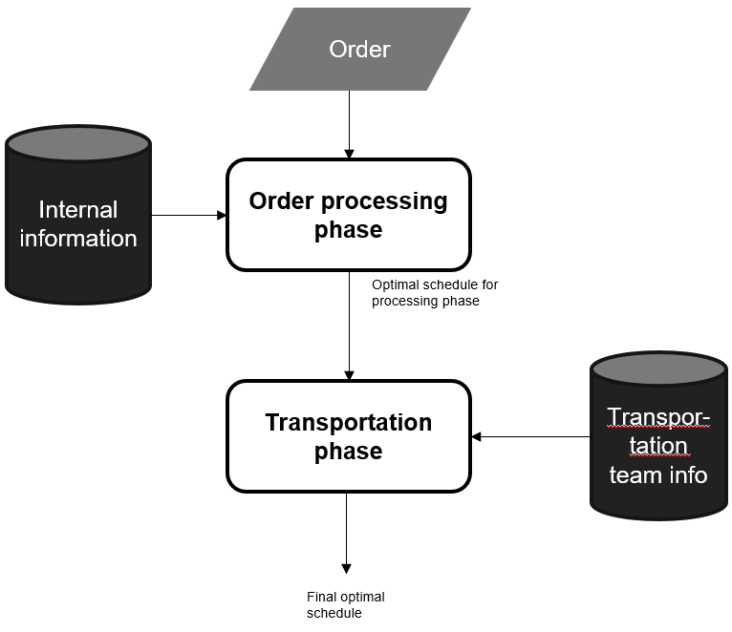
4. PRODUCT / SERVICE
Help customer find the optimal scheduling scheme for inventory / transportation processes
→ Minimize operation costs and total duration.
Main services:
Scheduling for warehouse handling
Scheduling for transportation
Constraints:
Resource ability (employees, machine, vehicles)
Customers’ time window

Slide 12
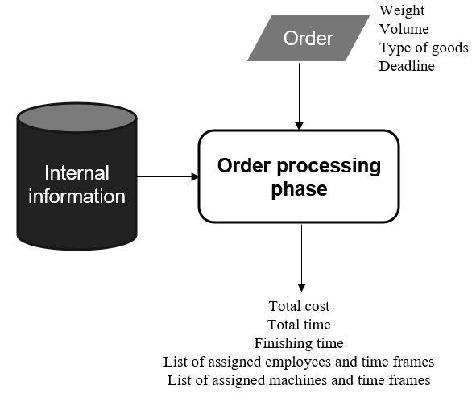
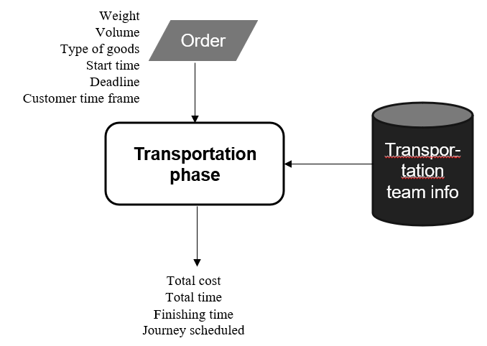
Detailed description

Slide 13
5. MARKET OVERVIEW AND COMPETITORS
 |  | Strength | Weakness | How it reduces costs
Processing phase | Opendock | Lets employee schedule online independently | No automatic recommendation for scheduling | Online schedule booking instead of working at company
Transportation phase | Vehicle Routing OR-Tools | Opensource, suitable for application development | Require professional background to implement | Calculate shortest paths to reach destination

Slide 14
6. TARGET CUSTOMERS
Customer:
Small to medium transportation company / inventory
Manual scheduling approach in order processing and/or transportation
Lackluster solutions in processing and / or transportation

Slide 15
7. COMPETITIVE ADVANTAGE
State-of-the-art genetic algorithm
Optimize cost and time duration for two important links in the supply chain: warehouse and transportation
Calculate based on employees’ wage and experience for order processing phase in the warehouse
Calculate based on the vehicle fleet’s abilities for transportation phase
Care for customer’s working time frame
Notes:
Selling point
State-of-the-art optimization algorithm
Inclusion of multiple internal constraints (employee, machine, vehicle abilities)
Inclusion of time constraints from customers.
Intuitive / User-friendly interface
Customizable variables

Slide 16
8. CURRENT BUSINESS STAGE
Currently under construction:
Formulate idea
Build core algorithm
Design UI

Slide 17
9. BUDGET AND/OR FINANCIAL STATUS
Tổng số tiền đầu tư dự án đã nhận được tới thời điểm hiện tại ? 0
Kế hoạch gọi vốn và sử dụng nguồn vốn (dự kiến) ?
Kết quả kinh doanh hiện tại. Tình hình doanh thu và doanh số ? Fetus project, has not deployed

Slide 18
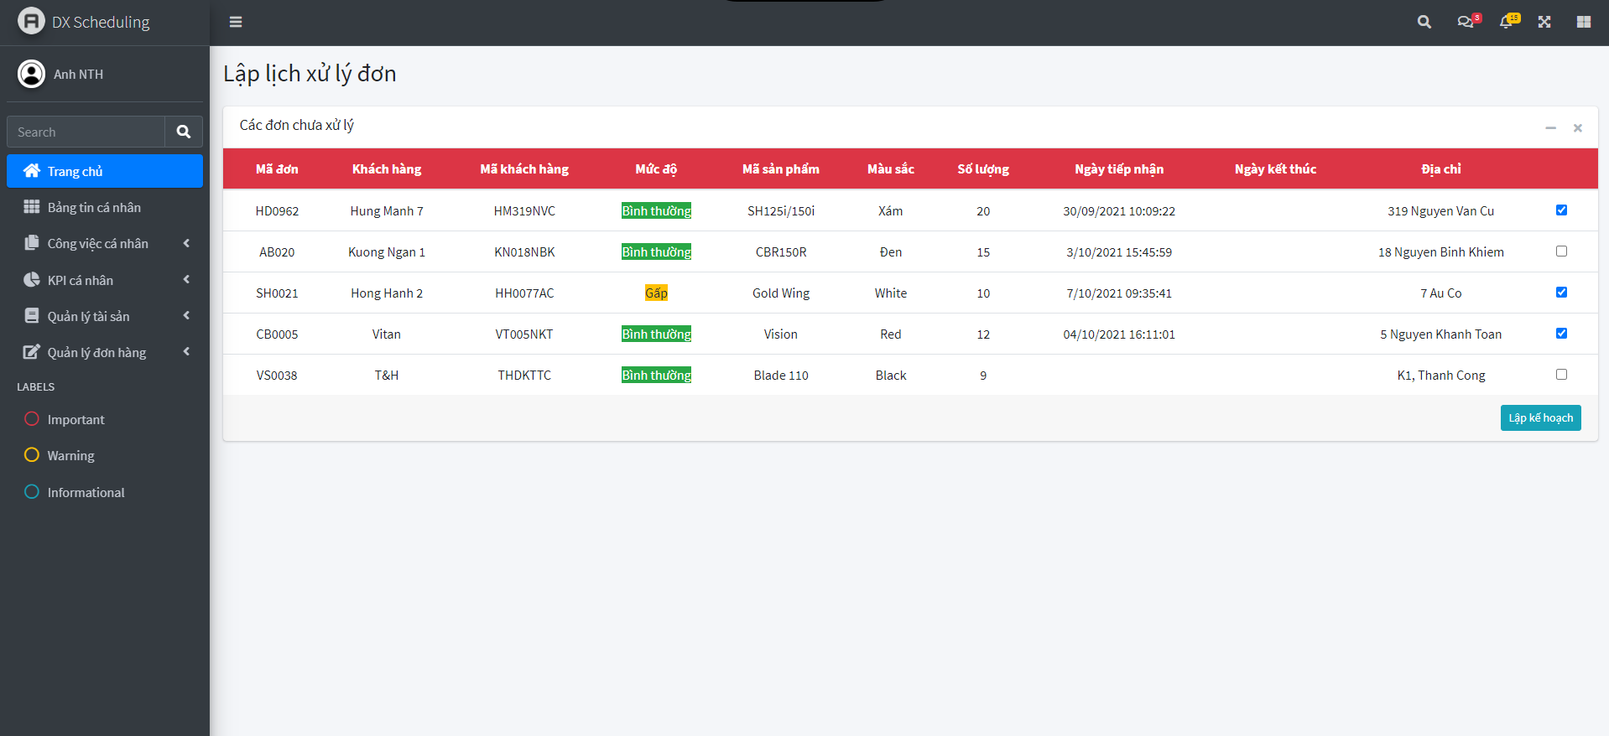
10. PRODUCT IMAGE - Warehouse: View pending orders

Slide 19
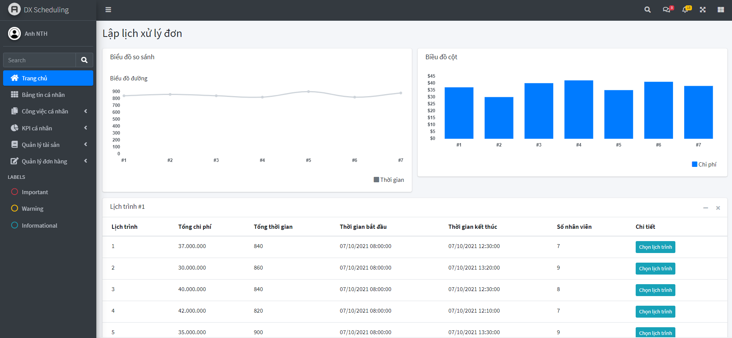
10. PRODUCT IMAGE - Warehouse: View calculated schedules

Slide 20
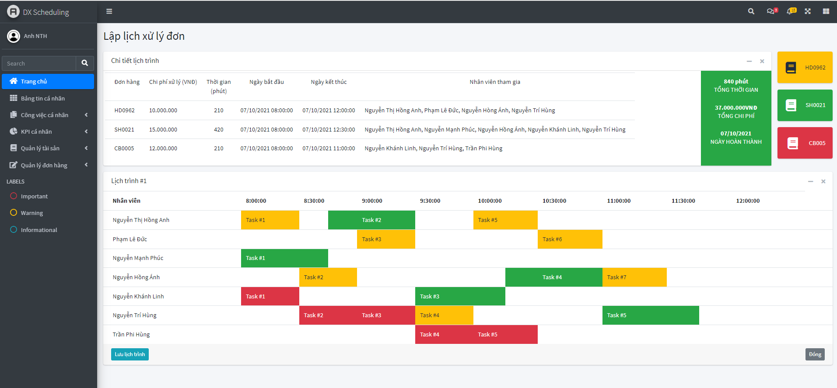
10. PRODUCT IMAGE - Warehouse: View detailed schedule

Slide 21
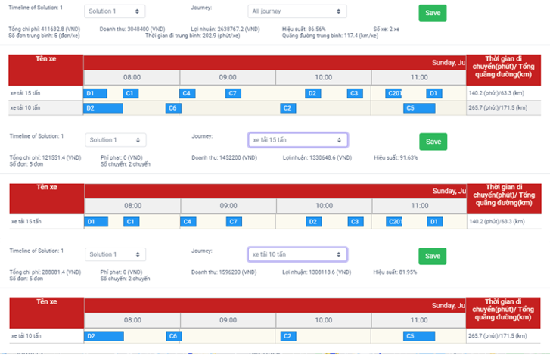
10. PRODUCT IMAGE - Transportation: View journeys

Slide 22
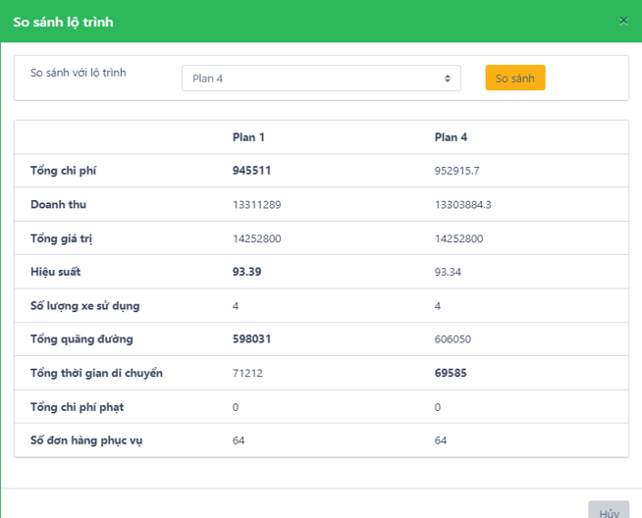
10. PRODUCT IMAGE - Transportation: Compare journeys

Slide 23
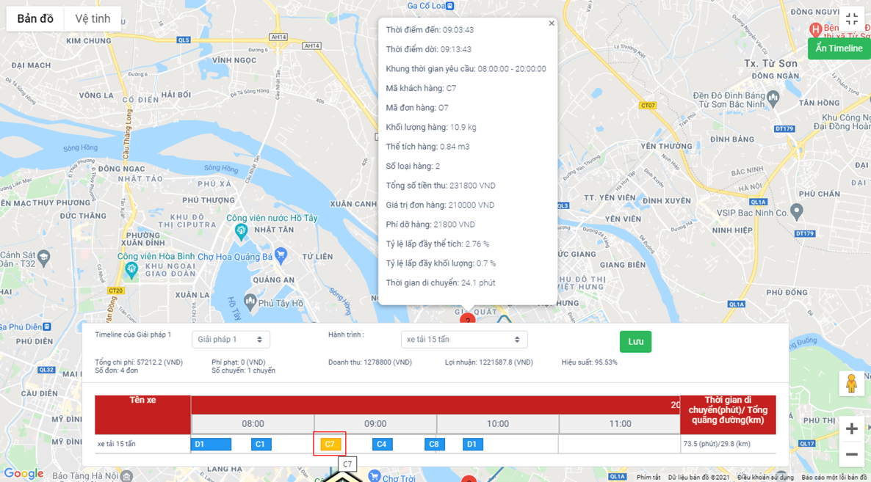
10. PRODUCT IMAGE - Transportation: View journey on map

Slide 24
11. BUSINESS LICENSE SCAN / PHOTO

Slide 25
12. COMPANY CONTACT
Full name: | Company:
Email: | Position:
Phone number: | Website:
Address | Facebook fanpage:

